Slide 1
HOUSE PRICE PREDICITION
Submitted by-
Ashu Chaudhary

Slide 2
Problem Statement Analysis
An US based housing company wanted to enter into Australian market and wanted to understand whether to invest or not.
They wanted to buy prospective properties and sell them at a higher price.
For this they have collected a dataset and want to know what are factors to predict the price and how these variables can impact the price.
They want to use various data science application to know whether it will be a profitable market to enter or not.

Slide 3
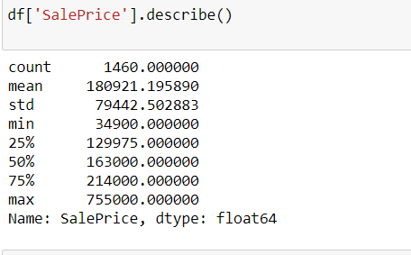
Exploratory data analysis process
From the above output parameters, we find out that how the sales price are distributed across the dataset using the describe function.

Slide 4

Exploratory data analysis process
Using the shape we find out the total number of rows & columns present in the dataset.

Slide 5
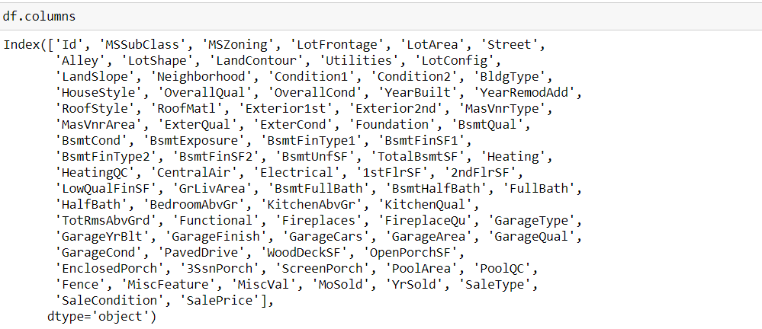
Exploratory data analysis process
By using columns function we find out name of each columns available in the dataset

Slide 6
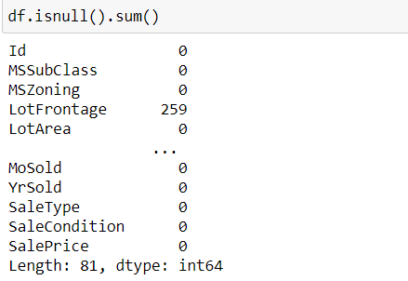
Exploratory data analysis process
From this function we find out the number of null values available in each columns that is the number of missing values available in each column

Slide 7
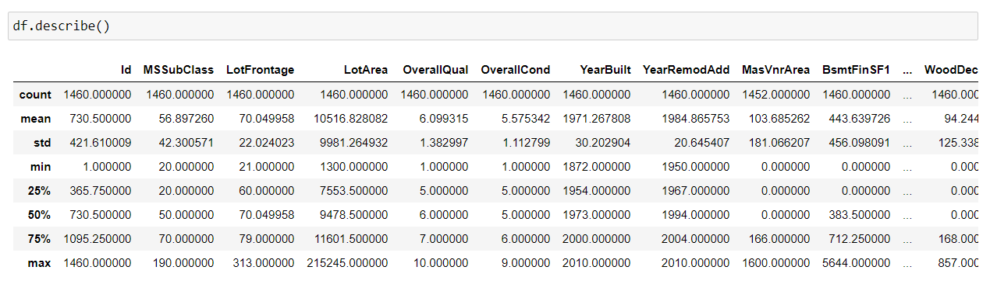
Exploratory data analysis process
From the describe method we got to know the five point summary analysis for a continuous variable.

Slide 8
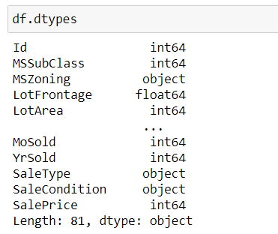
Exploratory data analysis process
By using “dtypes” we got to know the data types for each of the columns.

Slide 9
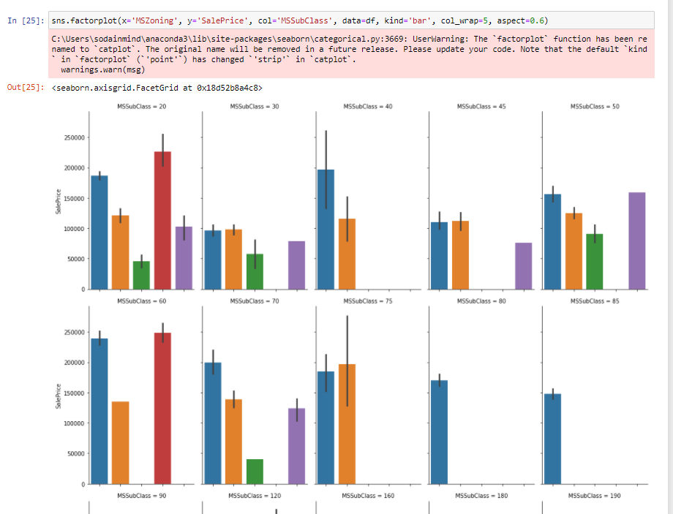
Data Visualization process
From the above factorplot I have understand the general zoning classification of the sale and sale price for the particular zone and also find out the type of dwelling involved in the sale of the house.

Slide 10
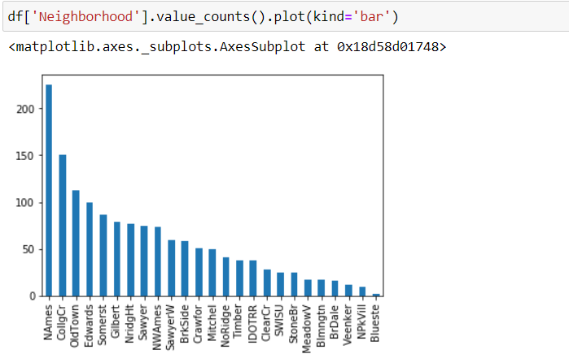
Data Visualization process
From the above bar plot we got to know the Physical locations within city limits.

Slide 11
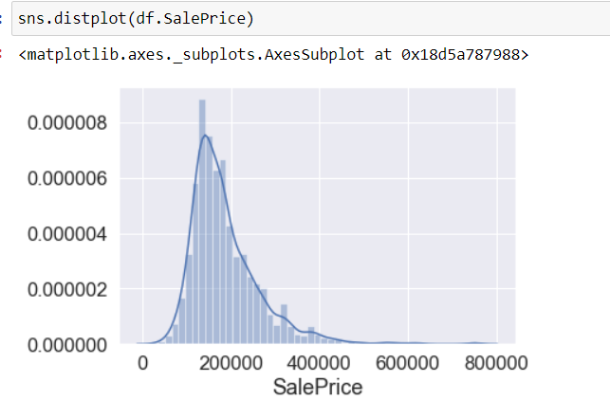
Data Visualization process
From the above distribution plot we find out how the house sales price are distributed using the univariate analysis.

Slide 12
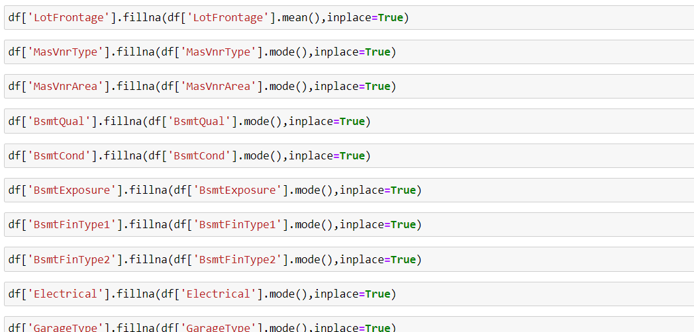
Data preprocessing stage
In this data preprocessing stage we have handled the missing values for few columns and replace them with mode/mean values.

Slide 13
Data preprocessing stage
In this pre processing stage, few of the columns are removed from further processing as they are unnecessary for model evaluation process.

Slide 14
Model building process
In this dataset, I assume that Saleprice is the target variable which is a continuous data, hence we have used various regression method for Machine learning model building process.
I have come across some features for missing values which handled as per the my understanding. Keep in mind that data is expensive and cannot afford to lose more than 8-9% of the data.
proposed a gradient boosting regressor model to predict the probability of house price prediction, also used cross validation to find the trade off between bias-variance.

Slide 15
Model Dashboard
ML Algorithm Used | Predicted Score
Random Forest Regressor | 87.54%
Decision Tree Regressor | 77.86%
Gradient Boosting Regressor | 90.18%
Ada Boosting Regressor | 83.43%
Extra Tree Regressor | 87.50%
Linear Regression | 88.39%
To predict the result of this dataset above are regression models used for evaluations.
Out of all the machine learning models used I have selected Gradient Bossing Regressor model for further evaluation of this dataset

Slide 16
CONCLUSIONS
I have used various regressor methods and out of all algorithm, gradient boosting regressor yields the best results.
I have also used cross validation technique to find the trade-off between bias& variance
This house price prediction can be used market development as well as for economic development of the country.

